Slide 1
Spring Security
prepared by- Vijay Kulkarni, Java Spring Trainer

Slide 2
Java Security Overview
One of the primary reasons Java technology is a "good fit" for networks is that it has a comprehensive security model designed into its architecture.
The safety features are built into the Java virtual machine.
Java security includes a large set of APIs, tools, and implementations of commonly-used security algorithms, mechanisms, and protocols.
The Java security APIs span a wide range of areas, including cryptography, public key infrastructure, secure communication, authentication, and access control.
Java's security mechanisms help make Java suitable for networks because they establish a needed trust in the safety of network-mobile code.

Slide 3
contd..
Java's security model is focused on protecting users from hostile programs downloaded from untrusted sources across a network.
Java provides a customizable "sandbox" in which Java programs run, mandatorily only inside its sandbox.
Java prohibits any action outside those boundaries. The sandbox for untrusted Java applets, for example, prohibits many activities, including:
Reading or writing to the local disk
Making a network connection to any host, except the host from which the applet came
Creating a new process
Loading a new dynamic library and directly calling a native method

Slide 4
contd..
The fundamental components responsible for Java's sandbox are:
Safety features built into the Java virtual machine and the
language class loader architecture
The class file verifier
The security manager and the Java API
Several built-in security mechanisms are operating as Java virtual machine bytecodes. The mechanisms are:
Type–safe reference casting
Structured memory access (no pointer arithmetic)
Automatic garbage collection (can't explicitly free allocated memory)
Array bounds checking
Checking references for null

Slide 5
Java EE Security Model
The JavaEE security model is a role–based, declarative model based on container–managed security, where resources are protected by roles that are assigned to users.
This model allows decoupling an application from its underlying security infrastructure since security can be specified separate from the application logic in an application deployment descriptor.
The container, where an application runs, provides security for the application according to a specifications in the deployment descriptor.
This model also allows embedding security data (annotations) in the application code that can be referenced in deployment descriptors.

Slide 6
Authorization and Authentication
A server authenticates the end-user of a Web application in the following ways: basic, form, or client-cert.
Data is obtained from the user, such as account name and password, that is processed by the server to create a credential or to deny access. The server authentication is specified in the D.D.
A security role is a set of users that can be specified in the application deployment descriptor or in the application code.
An application controls access to its resources (such as a Web module URL or a bean method) by specifying the roles that are allowed to perform a given operation on a resource.
During deployment, application-scoped roles are mapped to security entities in the running environment, such as users, a group of users, or principals. This mapping is specified in a different configuration file

Slide 7
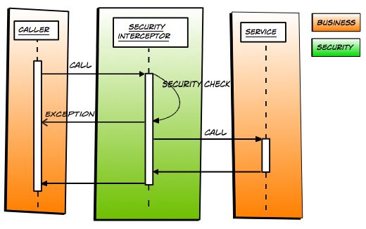
Diagrammatic Representation
prepared by- Vijay Kulkarni, Java Spring Trainer

Slide 8
Spring Security
Spring Security is a framework that
is powerful, customizable for authentication & access-control .
provides ways to perform authentication and authorization.
is the de–facto standard for securing Spring–based applications.
integrates well with Spring MVC and comes bundled with popular security algorithm implementations.
is proven technology, better to use than reinvent the wheel.
Security is something where its needed to take extra care, else the application will be vulnerable for attackers.
prepared by- Vijay Kulkarni, Java Spring Trainer

Slide 9
contd..
Features –
Comprehensive and extensible support for both Authentication and Authorization, support for groups and roles.
Protection against attacks like session fixation, clickjacking, cross site request forgery, etc
Easy to integrate in any web application. No need to modify web application configurations, spring automatically injects security filters to the web application.
Prevents some of the common attacks such as CSRF, session fixation attacks.
Provides support for authentication by different ways –
in–memory, DAO, JDBC, LDAP and many more.
Provides option to ignore specific URL patterns, good for serving static HTML, image files.
prepared by- Vijay Kulkarni, Java Spring Trainer

Slide 10
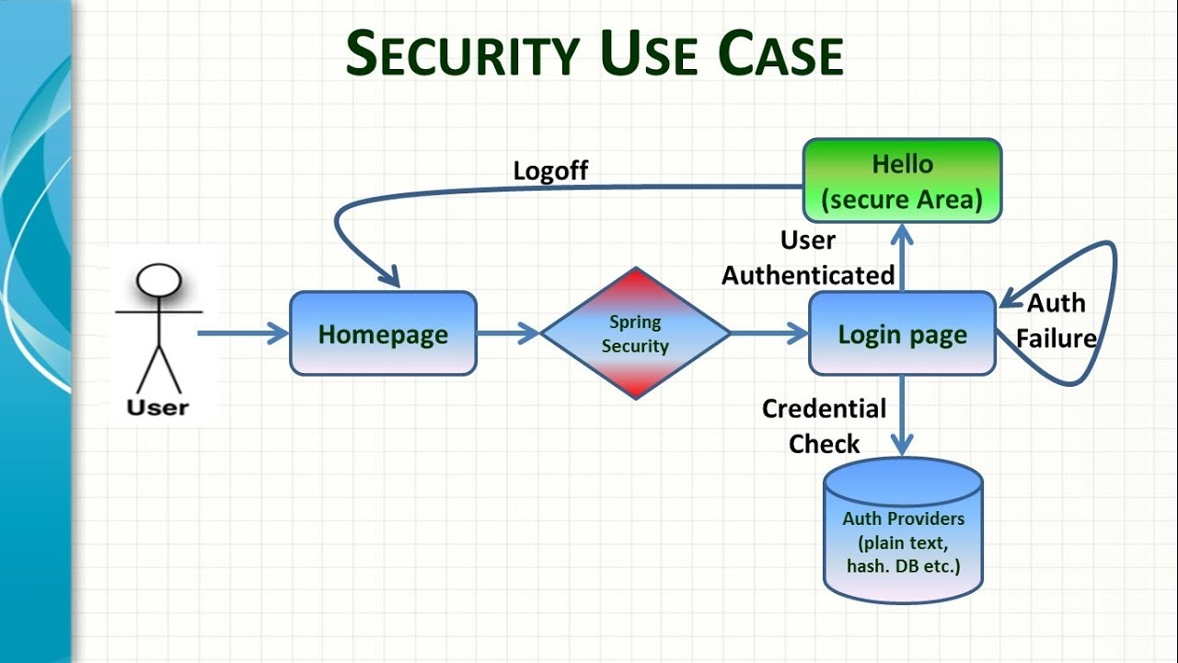
contd..
prepared by- Vijay Kulkarni, Java Spring Trainer

Slide 11
contd..
Application security boils down to two more or less independent problems:
authentication (who are you?) and
authorization (what are you allowed to do?).
These are sometimes referred as “access control”.
Spring Security has an architecture that is designed to separate authentication from authorization and has strategies and extension points for both.
Authorization is the process to allow authority to perform actions in the application viz.. to authorize web request, methods and access to individual domain.

Slide 12
Introduction
At its core, Spring Security is really just a bunch of servlet filters that help developer add to web application, authentication and authorization.
Any Spring web application is just one servlet: Spring’s DispatcherServlet that redirects incoming HTTP requests (e.g. from a browser) to @Controllers or @RestControllers.
There is no security hardcoded into that DispatcherServlet, its a raw HTTP Basic Auth header in @Controllers.
The authentication and authorization should be done before a request hits @Controllers.
prepared by- Vijay Kulkarni, Java Spring Trainer

Slide 13
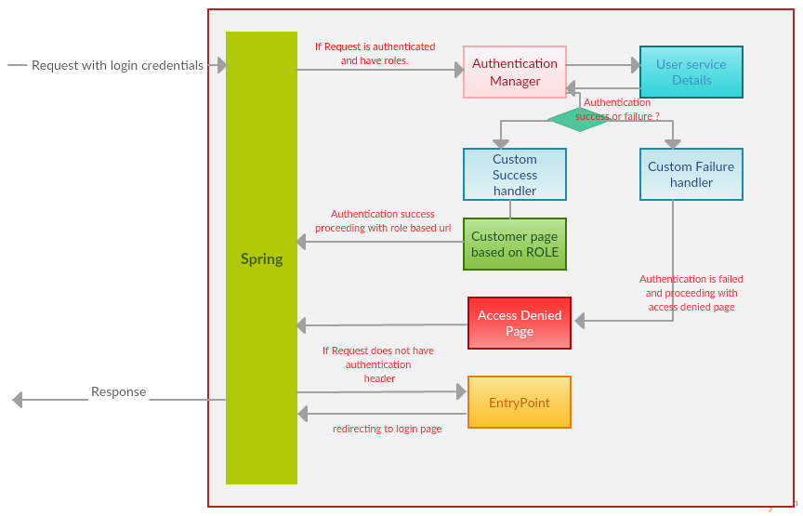
Diagrammatic Representation
prepared by- Vijay Kulkarni, Java Spring Trainer

Slide 14
Spring Security features
LDAP (Lightweight Directory Access Protocol) – It is an open application protocol for maintaining and accessing distributed directory information services over an Internet Protocol.
Single sign-on – This feature allows a user to access multiple applications with the help of single account(user name and password).
JAAS (Java Authentication and Authorization Service) LoginModule – It is a Pluggable Authentication Module implemented in Java. Spring Security supports it for its authentication process.
Basic Access Authentication – Spring Security supports Basic Access Authentication that is used to provide user name and password while making request over the network.

Slide 15
contd..
Digest Access Authentication – This feature asks browser to confirm user–identity before sending sensitive data on network.
Remember-me – Spring Security remembers to the user and avoid login again from the same machine until the user logsout.
Authorization–Spring Security provides this feature to authorize the user before accessing resources.
Software Localization – This feature allows us to make application user interface in any language.
HTTP Authorization – Spring provides this feature for HTTP authorization of web request URLs using Apache Ant paths or regular expressions

Slide 16
contd..
OAuth 2.0 Login – This feature from ver 5.0 provides the facility to the user to login into the application by using their existing account at GitHub or Google.
Reactive Support – Version 5.0 onwards, it provides reactive programming and reactive web runtime support and can be integrated with Spring WebFlux.
Modernized Password Encoding – A new Password encoder was introduced DelegatingPasswordEncoder which is more modernize and solve all the problems of previous encoder NoOpPasswordEncoder

Slide 17
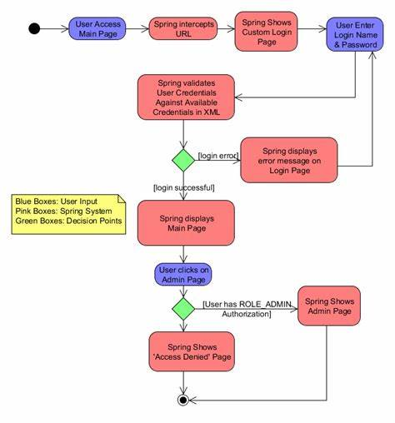
contd..
prepared by- Vijay Kulkarni, Java Spring Trainer

Slide 18
contd..
The Security module is divided into separate jar files. The purpose was to divide jar files based on their functionalities. This helps to set required dependency into pom.xml file of maven project.
The following are the jar files that are included into Spring Security module.
spring-security-core.jar
spring-security-remoting.jar
spring-security-web.jar
spring-security-config.jar
spring-security-ldap.jar
spring-security-oauth2-core.jar
spring-security-oauth2-client.jar
spring-security-oauth2-jose.jar
spring-security-acl.jar
spring-security-cas.jar
spring-security-openid.jar
spring-security-test.jar

Slide 19
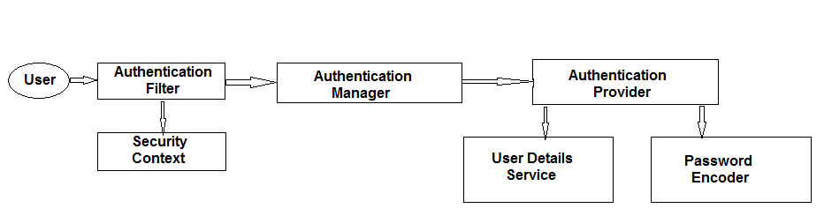
Spring Security Components
Authentication filter: The authentication filter receives user requests and forwards them to the authentication manager for authentication.
Authentication Manager: The authentication manager uses the authentication provider to perform the authentication process.

Slide 20
contd..
Authentication Provider: The authentication provider validates if the user exists in the system using the User details service and validates the password using the password encoder.
User details service: Implements user management responsibility. It searches for the existing user, which is used in the authentication of the user by the provider.
Password Encoder: Encodes the password before saving and matches the encoded password against a encode type.
Security Context: The security context holds the user details after the successful authentication and authorization process.
Spring security is a highly customizable framework. Any part of the framework can be customized. The framework configuration, such as authentication logic, custom representation of the user details, etc.

Slide 21
Annotations
@EnableWebMvc – @EnableWebMvc is used to enable Spring MVC is equivalent to <mvc:annotation-driven /> in XML. It enables support for @Controller-annotated classes that use @RequestMapping to map incoming requests to a certain method.
@EnableWebSecurity – The @EnableWebSecurity is a marker annotation. It allows Spring to find (it's a @Configuration and, therefore, @Component) and automatically apply the class to the global WebSecurity. @EnableWebSecurity is used for spring security java configuration. Usage of this annotation is to add with @Configuration on top of the security java class that extends WebSecurityConfigurerAdapter.

Slide 22
Interfaces
WebMvcConfigurer – Defines callback methods to customize the Java-based configuration for Spring MVC enabled via @EnableWebMvc . @EnableWebMvc – annotated configuration classes may implement this interface to be called back and given a chance to customize the default configuration.
The UserDetailsService interface is used to retrieve user-related data. It has one method named loadUserByUsername() which can be overridden to customize the process of finding the user.

Slide 23
Classes
Background – WebApplicationInitializer is used for booting Spring web applications. WebApplicationInitializer registers a Spring DispatcherServlet and creates a Spring web application context.
AbstractAnnotationConfigDispatcherServletInitializer, which is an implementation of the WebApplicationInitializer, to create Spring web applications.
Traditionally, Java web applications based on Servlets were using web.xml file to configure a Java web application. Since Servlet 3.0, created programatically via Servlet context listeners.
InMemoryUserDetailsManager – Non-persistent implementation of UserDetailsManager which is backed by an in-memory map. Mainly intended for testing and demonstration purposes, where a full blown persistent system isn't required.

Slide 24
contd..
AbstractAnnotationConfigDispatcherServletInitializer – a base class to initialize Spring application in Servlet container environment. It's an extension of WebApplicationInitializer. The subclasses are supposed to provide the classes annotated with @Configuration, Servlet config classes and DispatcherServlet mapping pattern.
It is a newly(3.2+ versions of Spring) introduced Template method based, base class that makes Spring pure java based web application Configuration(@Configuration) without using a web.xml.
HttpSecurity – It allows configuring web based security for specific http requests. By default it will be applied to all requests, but can be restricted using requestMatcher(Request Matcher) or other similar methods. Similar to Spring Security's XML <http> element.

Slide 25
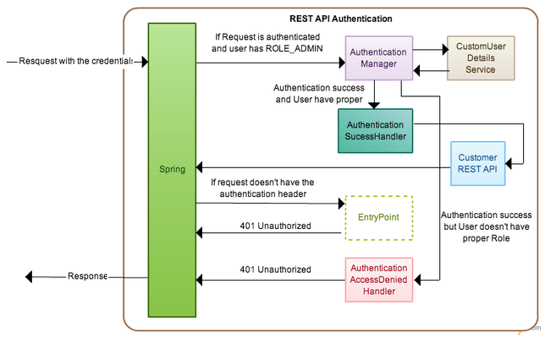
contd..
prepared by- Vijay Kulkarni, Java Spring Trainer

Slide 26
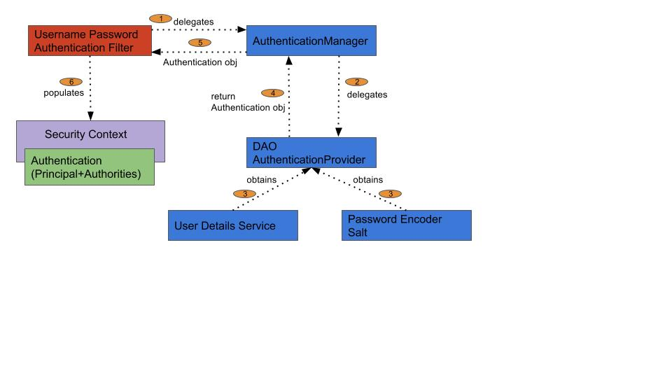
contd..
prepared by- Vijay Kulkarni, Java Spring Trainer

Slide 27
Oauth
Scenario – A web service exists where an user has registered. To access any resources on that service, the user must authenticate.
Now, a third–party application wants to integrate with that service and present data to the user.
The user could simply share his personal credentials with the third–party application. Results in user granting the third–party application unrestricted access to all their resources.
There is also no way for the user (or the service) to control or revoke the third–party application’s access.
OAuth addresses this problem by separating the application’s credentials from the user’s credentials. Its designed to give a user control over what resources an application may or may not access on behalf of the user without having to share credentials.

Slide 28
contd..
OAuth is an authentication protocol that allows user to approve one application interacting with another on user’s behalf without giving away user’s password.
OAuth uses Access Tokens. – An Access Token is a piece of data that represents the authorization to access resources on behalf of the end-user.
OAuth doesn't define a specific format for Access Tokens. However, in some contexts, the JSON Web Token (JWT) format is often used.
OAuth doesn't share password data but instead uses authorization tokens to prove an identity between consumers and service providers.

Slide 29
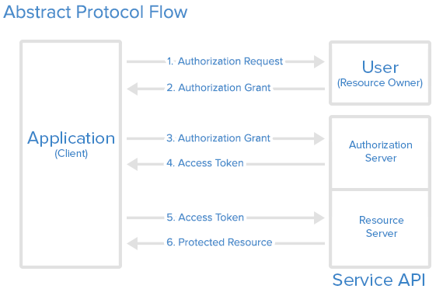
contd..

Slide 30
contd..
The formal roles within OAuth are:
The resource owner: The entity granting access to some resources, often the end-user.
The resource server: The entity hosting the protected resources, such as an API. The resource server requires and validates access tokens as part of processing requests.
The (OAuth) client: The application that requests access to protected resources on behalf of the resource owner. It uses the access token to prove authorization.
The authorization server: The entity that authenticates the resource owner, obtains authorization, and issues access tokens to the client.

Slide 31
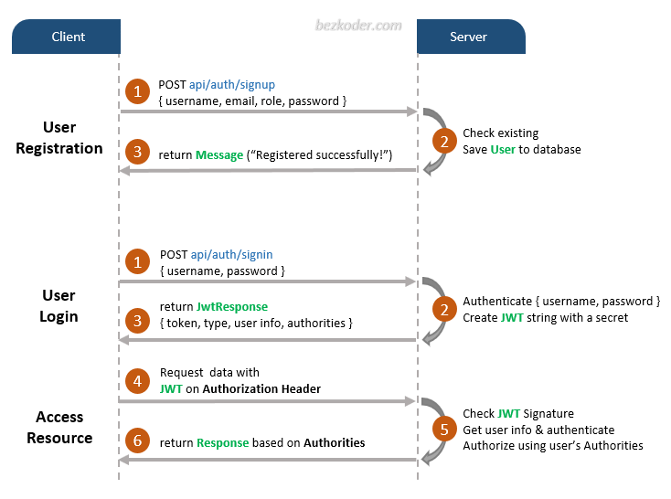
contd..

Slide 32
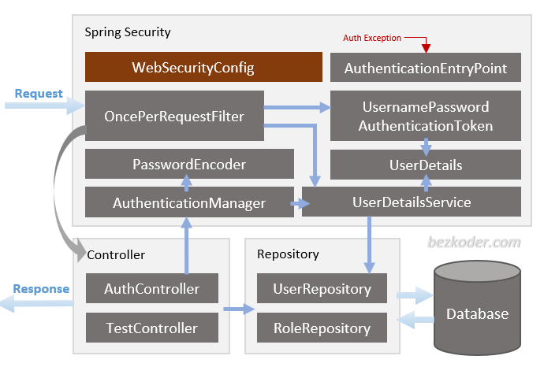
contd..

Slide 33
contd..
WebSecurityConfig – is the crux of our security implementation. It configures cors, csrf, session management, rules for protected resources. Can also extended and customized.
UserDetailsService interface has a method to load User by username and returns a UserDetails object that Spring Security can use for authentication and validation.
UserDetails contains necessary information (such as: username, password, authorities) to build an Authentication object.
UsernamePasswordAuthenticationToken gets {username, password} from login request. AuthenticationManager will use it to authenticate a login account.
AuthenticationManager has a DaoAuthenticationProvider (with help of UserDetailsService & PasswordEncoder) to validate UsernamePasswordAuthenticationToken object. If successful, AuthenticationManager returns a fully populated Authentication object (including granted authorities).

Slide 34
contd..
OncePerRequestFilter makes a single execution for each request to the API. It provides a doFilterInternal() method that will implement parsing & validating JWT, loading User details (using UserDetailsService), checking Authorizaion (using UsernamePasswordAuthenticationToken).
AuthenticationEntryPoint will catch authentication error.
Repository contains UserRepository & RoleRepository to work with Database, will be imported into Controller.
Controller receives and handles request after it was filtered by OncePerRequestFilter.
AuthController handles signup/login requests
TestController has accessing protected resource methods with role based validations.

Slide 35
Thank You
prepared by- Vijay Kulkarni, Java Spring Trainer

